Slide 1

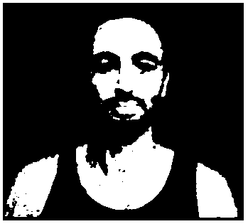
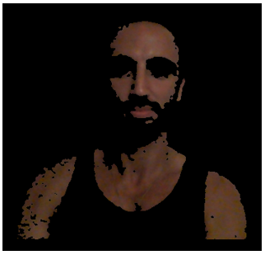
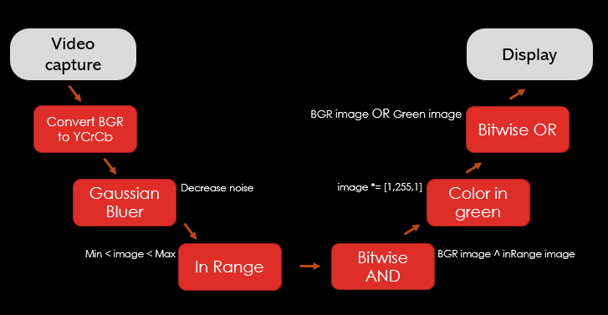
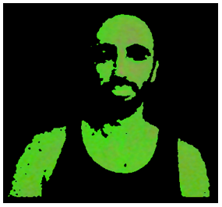
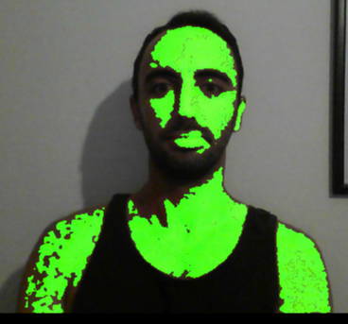
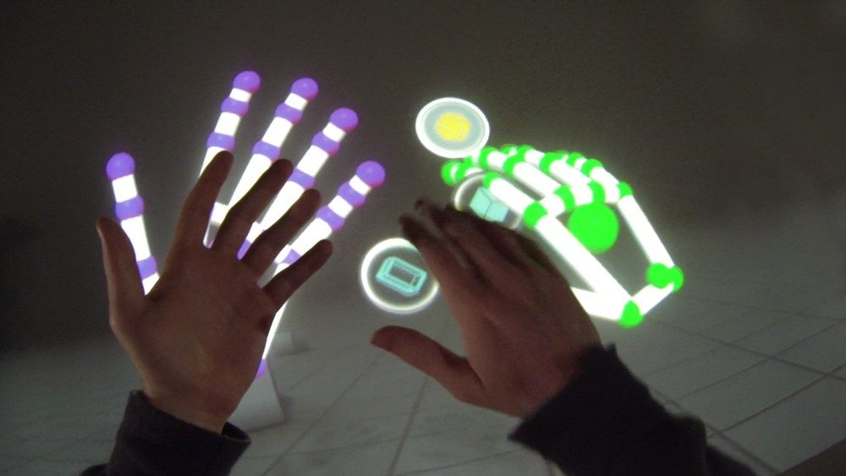
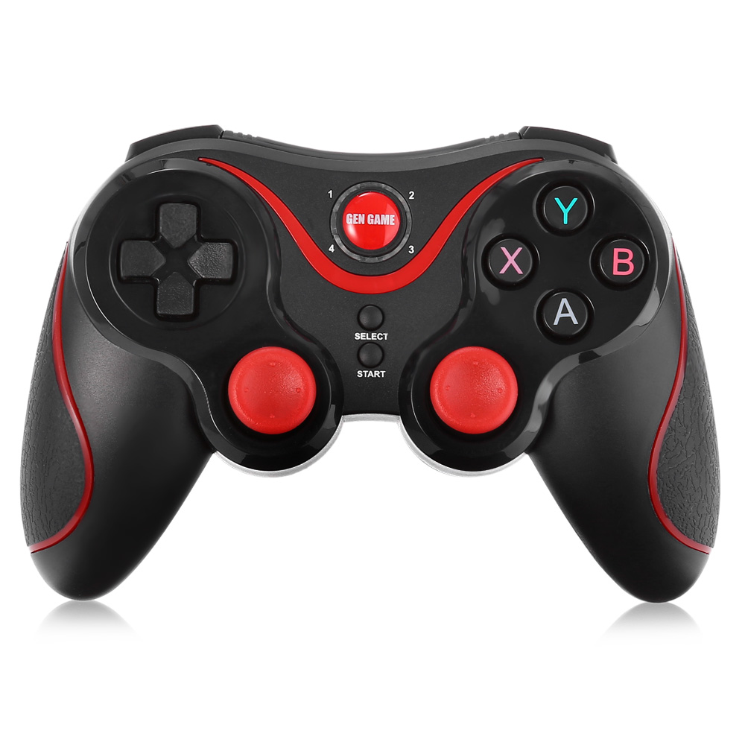
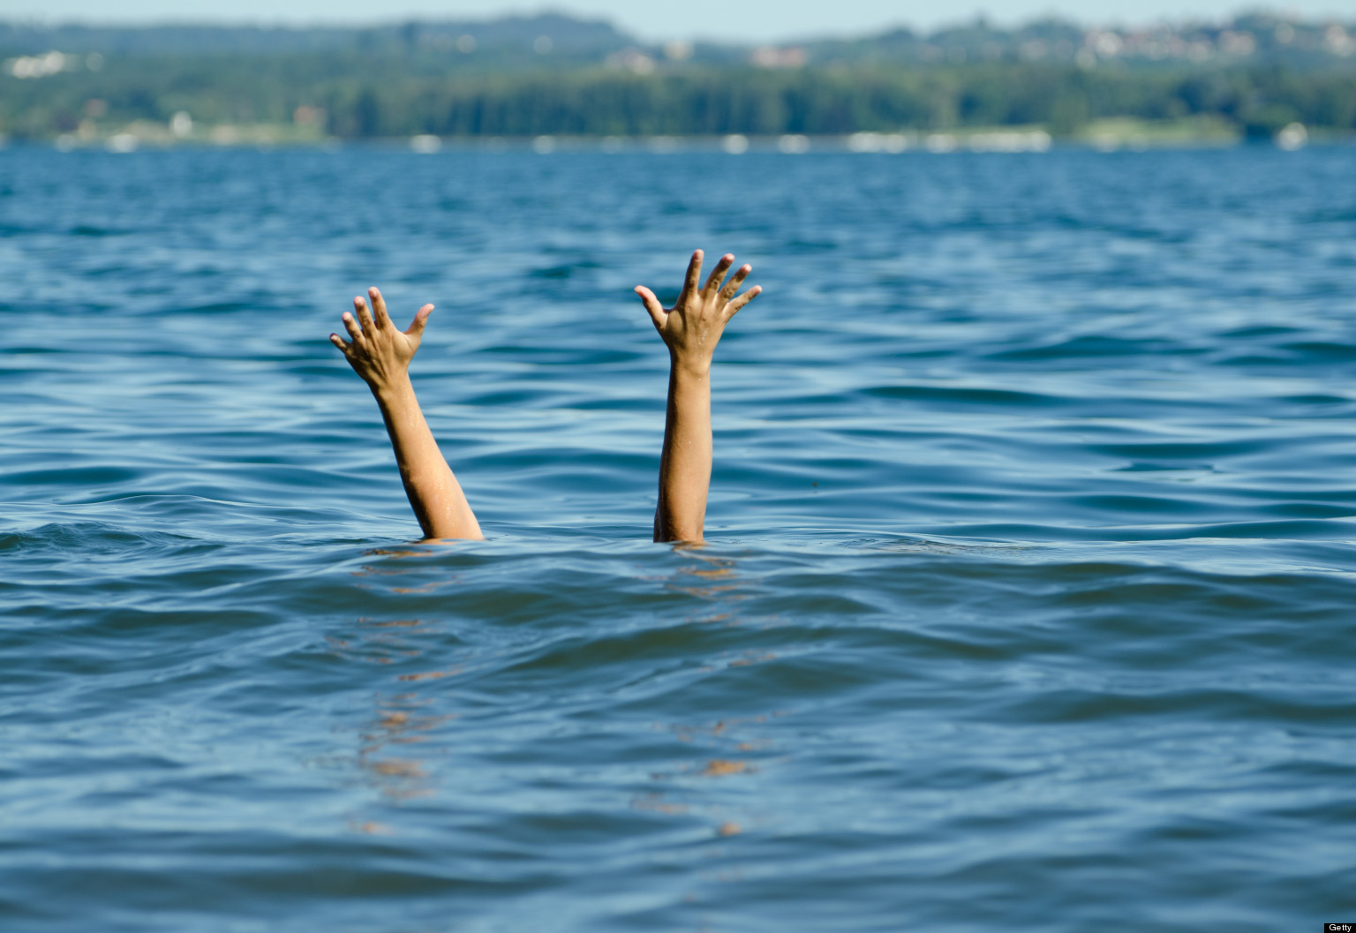
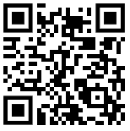
algorithm multimedia and machine learning in python | Skin Detection Jacob Graham
Dimitry Patashov
Introduction:
Skin Detection Application is used for detecting human skin in a live video
and coloring it in green.
Skin detection is the process of finding skin-colored pixels and regions
in an image or a video.
by using computer vision algorithms , from the OpenCV Library in Python.
Info:
Application process:
we create a matrix that were skin is detected it’s white. We then color it in
Green, and return the green image into the video captured image.
Conclusions:
the result is a good detection rate ,with future development we may achieve a more
Accurate, with higher detection rate.
Discussions:
This project my have many option for future development.
by using this technology we can apply applications.
for example: Gesture tracking, Games controller ,Life saving systems..
Scan Me:
https://github.com/Jacob22g/My-Projects.git
You are not allowed to change poster size B1 (70x100 cm).
You are not allowed to change the header section format.
Project name size should be between 74-78.
Section titles should have size between 52-56.
Lecturer name and participants names should have size between 52-56.
Course name should have size between 38-42.
Body texts of the poster should have size between 32-38.
Replace the current text in the header with correct information.
You may change the colors, fonts and font sizes of the header within the restrictions as long as header size and format stay unchanged.
You may design the body section as you please but under these constrains:
Body must include the following sections in this exact order:
Introduction – overview of the project.
<Read part (b)>
Conclusions – achieved goals, received results and their comparison to the defined targets of project as set at its beginning.
Discussions – vision of further development of the project, QR code to the video and source codes of the project (if applicable).
In (a), the blank paragraph is where you add your own section/s. You must add at least one section and you cannot add more than two sections.
When you submit the poster, do so in two files: powerpoint presentation (this file) and PDF file.
Any images, graphs or charts included in the poster, must have high resolution, sharp markings and texts.
This poster template is in accordance with written above limitations.

